Slide 1
Concurrency
Week 2
Processes

Slide 2
Contents
Processes
Scheduling and Context Switching
Inter-process communication

Slide 3
Processes

Slide 4
Process Concept: What is a Process?
An operating system executes a variety of programs:
Text editors
Data processing
Web applications
Interactive games
Process – a program in execution; process execution must progress in sequential fashion

Slide 5
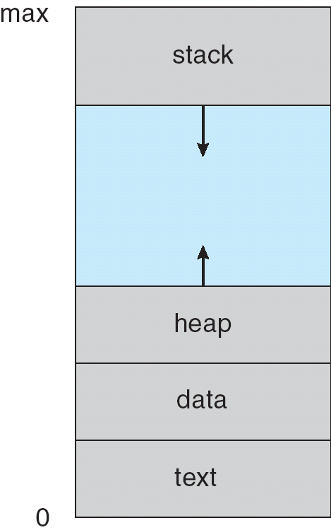
How a Program is Put in Execution?
To put a program in execution we should:
Copy it (at least partially!!) into the main memory
Set the program counter (pc) to point to the first instruction
Initialize stack
Reset flags
The process is ready, start running …

Slide 6
Question time!
Q: What is the difference between a program and a process?
We discussed this extensively in op4 last year

Slide 7
Answer:
Process – a program in execution; process execution must progress in sequential fashion (as from the slides before…). It is an active entity born from a program.
A program can have multiple processes (initiates/owns)
Multiple processes can be part of a program
Both a program and process perform a task

Slide 8
What Resources are Used by a Process?
A process has its own:
Code, data, and stack
Usually (but not always, when not?) has its own address space
Program state
CPU registers
Program counter (current location in the code)
Stack pointer
Only one process can be running in the CPU at any given time!
Notes:
Possible extra resource: https://www.youtube.com/watch?v=b4fsyrWegGo

Slide 9
The Process Model: Multiprogramming
Multiprogramming of 4 programs
Conceptual model
4 independent processes
Processes run sequentially
Only one program is active at any instant!
That instant can be very short…
D
C
B
A
Time
Single PC (CPU’s point of view)
Multiple PCs (process point of view)
A
B
A
B
C
D
C
B
D

Slide 10
When is a Process Created?
Processes can be created in two ways
System initialization: one or more processes created when the OS starts up
Execution of a process creation system call: something explicitly asks for a new process
System calls can come from
From user request to create a new process (system call executed from user shell, for instance, when a user clicks on an icon on the desktop)
From already running processes
User programs
System daemons
Notes:
Notes:
System daemons: process that runs in background

Slide 11
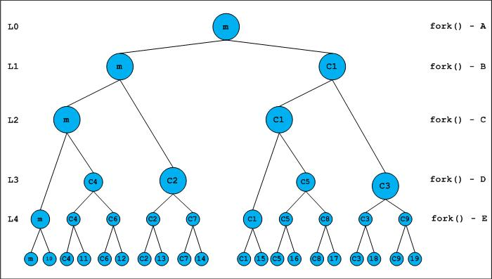
Process Creation and identification
Generally, process identified and managed via a process identifier (pid)
Creation chain:
Parent process creates children processes, which, in turn create other processes, forming a tree of processes

Slide 12
Process Creation
Resource sharing options
Parent and children share all resources
Children share subset of parent’s resources
Parent and child share no resources
Execution options
Parent and children execute concurrently
Parent waits until children terminate

Slide 13
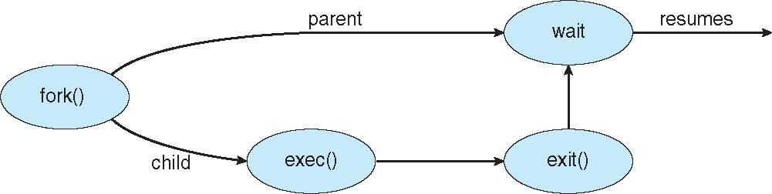
Process Creation (Cont.)
Address space
Child duplicate of parent
Child has a program loaded into it
UNIX examples
fork() system call creates new process
exec() system call used after a fork() to replace the process’ memory space with a new program
Notes:
Note:
Can we write a program that creates a process? Is a fork() system call to os?
Coding example: https://docs.microsoft.com/en-us/dotnet/api/system.diagnostics.process.start?view=netframework-4.8
Processes in C#: https://docs.microsoft.com/en-us/dotnet/api/system.diagnostics.process?view=netframework-4.8

Slide 14
When do Processes End?
Conditions that terminate processes can be
Voluntary
Involuntary
Voluntary
Normal exit: when the process has no more instruction to execute.
Error exit
Involuntary
Fatal error
Killed by another process

Slide 15
Process Termination
Process executes last statement and then asks the operating system to delete it using the exit() system call.
Returns status data from the child to the parent (via wait())
Process’ resources are deallocated by operating system
Parent may terminate the execution of children processes using the abort() system call.
Some reasons for doing so:
Child has exceeded allocated resources
Task assigned to child is no longer required
The parent is exiting and the operating systems does not allow a child to continue if its parent terminates

Slide 16
Process Termination
Some operating systems do not allow a child to exist if its parent has terminated. If a process terminates, then all its children must also be terminated.
cascading termination. All children, grandchildren, etc. are terminated.
The termination is initiated by the operating system.
The parent process may wait for termination of a child process by using the wait()system call. The call returns status information and the pid of the terminated process
pid = wait(&status);
If no parent waiting (did not invoke wait()), process is a zombie (*NIX)
If parent terminated without invoking wait(), process is an orphan (*NIX)

Slide 17
Process hierarchies
Parent creates a child process
Child processes can create their own children
Forms a hierarchy
UNIX calls this a “process group”
If a process exits, its children are “inherited” by the exiting process’s parent
Windows has no concept of process hierarchy (in its base definition)
All processes are created equal
we can specify now how the inheritance work with code (Win10)

Slide 18
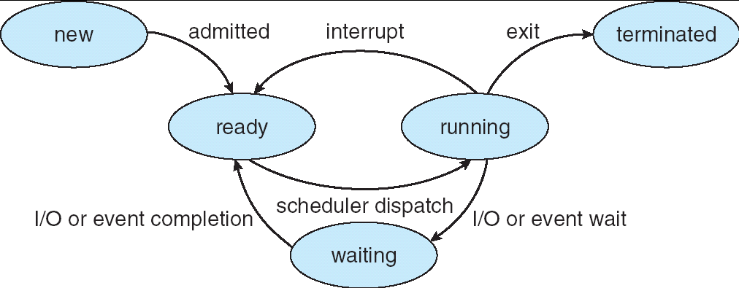
Process State
As a process executes, it changes its state
new: The process is being created
running: Instructions are being executed
waiting: The process is waiting for some event to occur
ready: The process is waiting to be assigned to a CPU
terminated: The process has finished execution

Slide 19
Process State Transition
Created
Possible transitions between states are
1 - Process enters ready queue
2 - Scheduler picks this process
3 - Scheduler picks a different process
4 - Process waits for event (such as I/O)
5 - Event occurs
6 - Process exits
7 - Process ended by another process
1
Ready
2
5
3
Blocked (waiting)
Running
4
7
6
7
Exit

Slide 20
What is a Process Control Block?
All information about a process is stored in a data structure named Process Control Block (PCB)
Process management
Registers
Program counter
CPU status word
Stack pointer
Process state
Priority / scheduling parameters
Process ID
Parent process ID
Signals
Process start time
Total CPU usage
File management
Root directory
Working (current) directory
File descriptors
User ID
Group ID
May be stored on stack
Memory management
Pointers to text, data, stack
or
Pointer to page table
Notes:
one entry of a process table

Slide 21
Scheduling and Context Switching

Slide 22
Switching from Process to Process
Running multiple processes at the same time requires sharing CPU time (Assuming single CPU/core)
Stopping a process and allocating CPU to another process is named context switching
Context switching is used for:
Maximizing CPU utilization by running a ready process when the current process is blocked (waiting for I/O for instance)
Creating the illusion of multi-processor system on single-processor systems by running each process for a short period named a quantum.
Context-switch time is an overhead; the system does no useful work while switching context

Slide 23
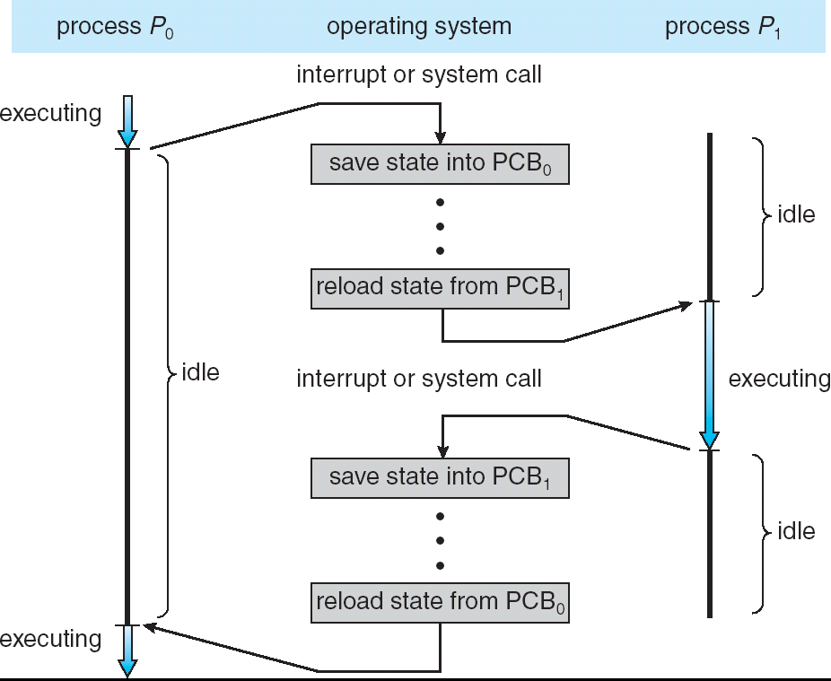
Context Switching

Slide 24
Process Scheduling
Context switching requires choosing a process to allocate CPU when the CPU is withheld form the current process.
Process scheduling refers to the methods used for selecting the next process to run (see Operating System course for the details)
To apply process scheduling algorithms, multiple queues are created
Notes:
Notes:
Students may not know the concept of the queue. Need more clarification.

Slide 25
Process Scheduling Queues
Job queue – set of all processes in the system
Ready queue – set of all processes residing in main memory, ready and waiting to be executed
Device queues – set of processes waiting for an I/O device
Processes migrate among the various queues

Slide 26
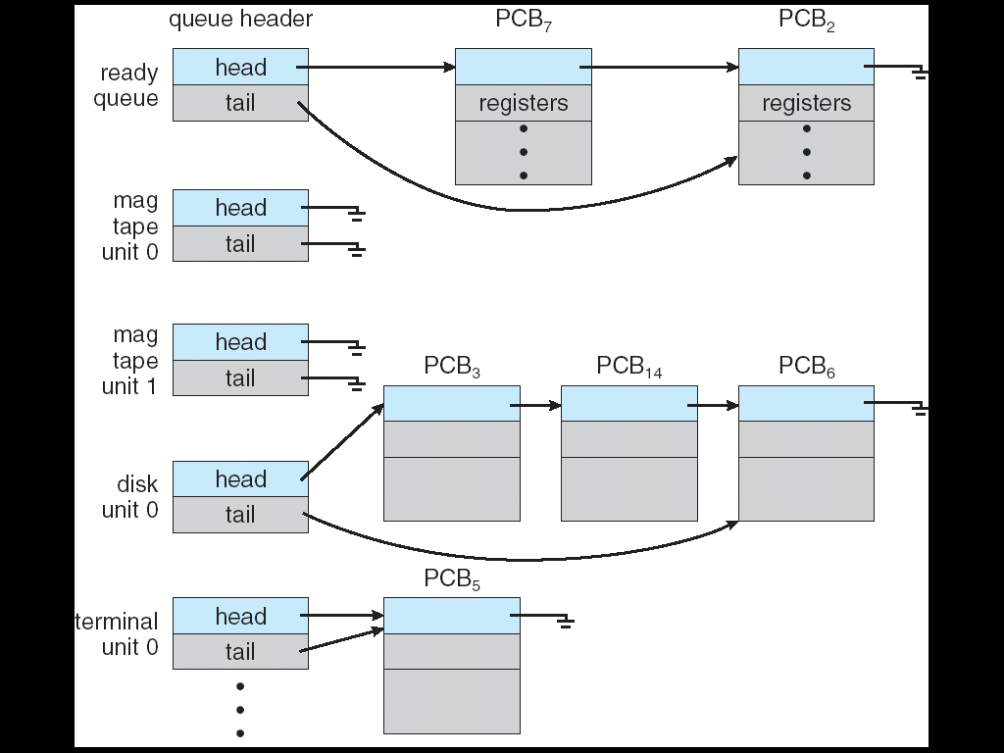
Ready Queue and Various I/O Device Queues

Slide 27
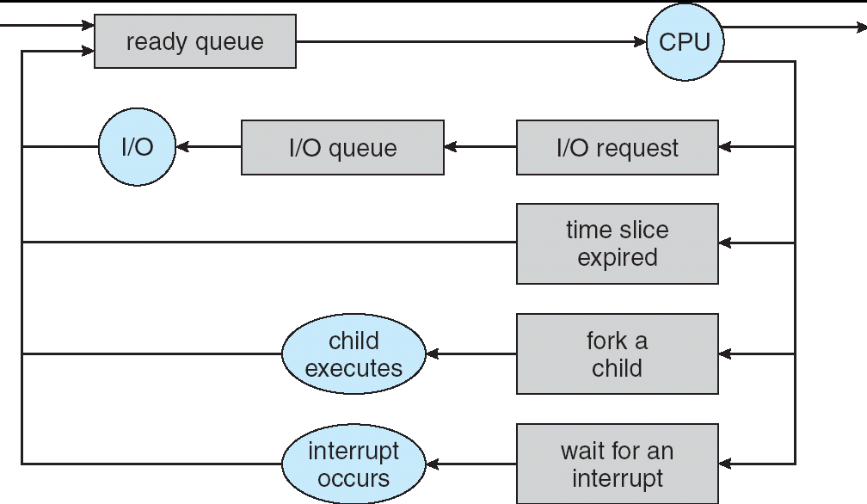
Simplified Model of Process Scheduling

Slide 28
Schedulers
Long-term scheduler (or job scheduler) – selects which processes should be brought into the ready queue from the job queue
Long-term scheduler is invoked very infrequently (seconds, minutes) ⇒ (may be slow)
The long-term scheduler controls the degree of multiprogramming
Short-term scheduler (or CPU scheduler) – selects which process should be executed next and allocates CPU
Short-term scheduler is invoked very frequently (milliseconds) ⇒ (must be fast)
Processes can be described as either:
I/O-bound process – spends more time doing I/O than computations, many short CPU bursts
CPU-bound process – spends more time doing computations; few very long CPU bursts

Slide 29
Folder name: Processes.
Practicum… go to github
Ex.: W2.A (see G.classroom)
T:30min

Slide 30
Inter-process communications

Slide 31
Process Classes (kinds)
Independent process cannot affect or be affected by the execution of another process
Cooperating process can affect or be affected by the execution of another process
Advantages/objectives of process cooperation
Information sharing
Computational speed-up (given the right conditions)
Modularity (ease of maintenance and abstractions of tasks)
Convenience

Slide 32
Example: Cooperating Processes
Producer-Consumer Problem
A process named producer generates data items. A second process named consumer utilizes the data
producer process shares the information with the consumer process using a share buffer which can be either a(n):
unbounded-buffer places no practical limit on the size of the buffer
bounded-buffer assumes that there is a fixed buffer size

Slide 33
Inter-Process Communication (IPC)
Mechanism for processes to communicate and to synchronize their actions
Message system – processes communicate with each other without resorting to shared variables
IPC facility provides two operations:
send(message) – message size fixed or variable
receive(message)
If P and Q wish to communicate, they need to:
establish a communication link between them
exchange messages via send/receive
Implementation of communication link
physical (e.g., shared memory, hardware bus)
logical (e.g., logical properties)

Slide 34
Facilitating Inter-Process Communication
If the cooperating processes share information for computation speed-up or modularity, they can be part of the same process.
Being part of the same process makes it possible to
Share the code
Share the data
Share the resources
However each one should have its own
Stack
Registers
Program counter
Each sub-part of a process is named a thread (next week)

Slide 35
Interprocess Communication
Processes within a system may be independent or cooperating
Cooperating process can affect or be affected by other processes, including sharing data
Reasons for cooperating processes:
Information sharing
Computation speedup
Modularity
Convenience
Cooperating processes need inter-process communication (IPC)
Two models of IPC
Shared memory
Message passing

Slide 36
Let’s do a recap!

Slide 37
Summary
A process is a program in execution
A process is created at system initialization, or through a system call issued another process
Processes may terminate voluntarily or killed by another process
Processes may take different states during execution
Operating system revokes CPU from the running process and grants it to another process, a procedure called context switching
Operating systems using different scheduling algorithms to decide which process should run next

Slide 38
Folder name: IPCNamedClient IPCNamedServer
Practicum… go to github
Ex.: W2.B-C (see G.classroom)
T: as much as needed!

